Slide 1


Abstra
Lazar Milicevic
Weekly support report
Support, Challenges, Sollutions
11.02.2024

Slide 2
Agenda
Please find the full detailed report
HERE :)
1. Zendesk ↔ AWS Integration Progress
3. Challenges & Solutions
5. Questions & Clarifications
2. Zendesk Ticket Management & Weekly Rotation etc.
4. Next Steps

Slide 3
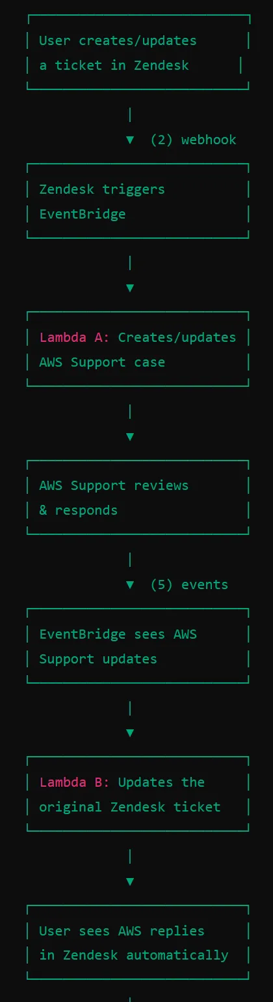
Zendesk ↔ AWS Integration Progress
Customer success: Weekly Support Report – 30.01.2025
What was done:
✅ AWS Support Cases
✅ The integration between Zendesk and AWS Support is now fully operational in production!.
Over 1000+ lines of code written.
Conducted 120+ test tickets in Zendesk and 400+ Zendesk updates.
Successfully tested 120+ AWS console test cases before moving from sandbox to production.
Key achievements:
Two-way sync between Zendesk & AWS.
AWS engineers can now respond directly within Zendesk.
Improved tracking of AWS support cases within Zendesk.
Full documentation is available:
Technical Guide - AWS Zendesk Support Integration

Slide 4
Zendesk Ticket Management & Weekly Rotation etc.
Customer success: Weekly Support Report – 30.01.2025
✅ Created a structured onboarding guide for hackathon winners.
✅ Processed and routed numerous tickets over the past week.
✅ Developed a new Zendesk form with 28 fields and dynamic logic.
📌 Abstra Onboarding Guide for Hackathon Winners
✅ Structured and Ready for Use!
Includes all essential links and documentation to ensure a smooth onboarding process.
Not yet distributed, pending final internal review.
Available on Notion:
Abstra Onboarding Guide for Hackathon Winners
📌 Zendesk Ticket Management & Weekly Rotation
✅ Efficient Ticket Processing & Cleanup
Processed and routed numerous Zendesk tickets, ensuring timely responses.
Enhanced Zendesk visibility by updating views:
New "SageMaker Blocking Issues - AWS Tickets" View for better tracking.
Completed weekly Zendesk rotation, notifying agents and clearing backlog.
Queue fully cleaned, ensuring a smooth and efficient support workflow.
📌 New "Data Product Requests" Form
Enhanced Internal Request Management
Developed a powerful new Zendesk form with 28 fields and dynamic logic.
Designed to streamline internal processes and improve data requests.
Form structured based on official documentation:
📄 [Proposal-Process-Workflow-to-Contact-Data-Group]

Slide 5
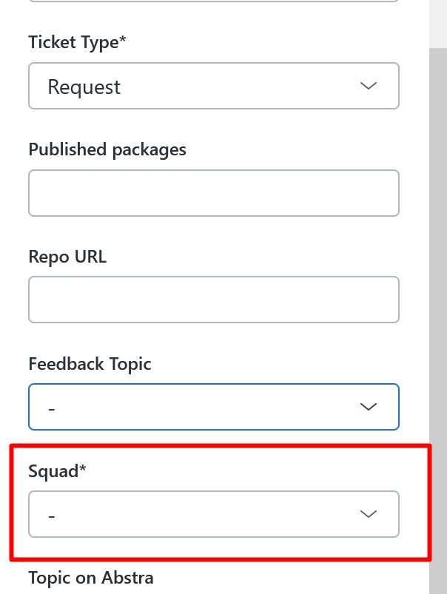
Challenges & Solutions
Customer success: Weekly Support Report – 30.01.2025
Some of them:
🔍 Issue: Assigning Tickets to the L2 Team
Assigning a ticket to L2 without setting the Squad field made it invisible to on-call agents.
✅ Solution:
Now ensuring the Squad field is always set when assigning tickets to L2.
🔍 Issue: Incorrect EventBridge Rule Matching AWS Payloads
EventBridge rules did not properly filter AWS notifications, causing unnecessary Lambda executions on irrelevant events.
✅ Solution:
Adjusted event pattern filters to ensure only relevant AWS events (such as case status changes) are passed to Zendesk.

Slide 6
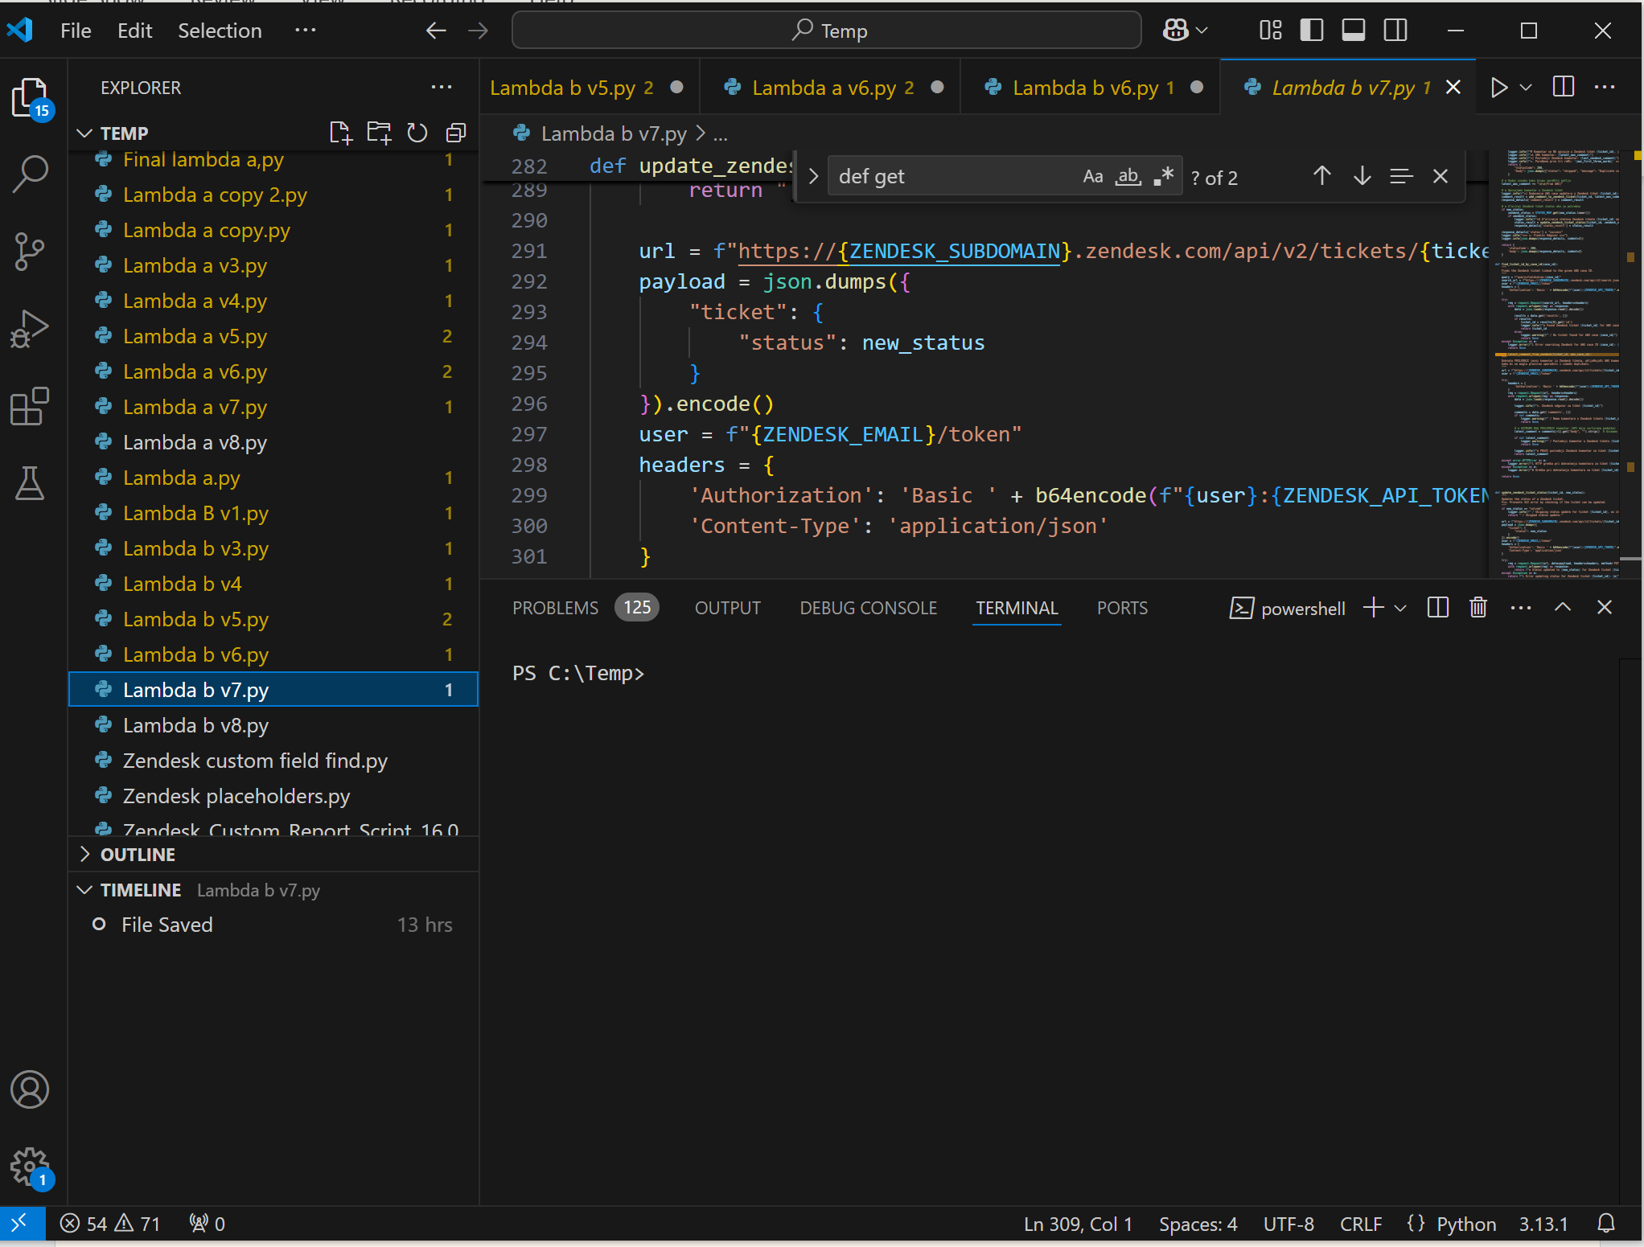
Next Steps
Customer success: Weekly Support Report – 30.01.2025
What will be done:
Finalize AWS-Zendesk integration documentation and continue monitoring live usage.
Communicate AWS-Zendesk changes with users & provide guidance.
Review and distribute the Abstra Onboarding Guide to hackathon winners.
Continue improving Zendesk workflow and Data Product Requests Form.
Address pending Linear tasks:
    TRA-70: 30-min walkthrough/Q&A.
    TRA-52: Restricting SageMaker/Data Catalog access.

Slide 7

Questions & Clarifications
Customer success: Weekly Support Report – 30.01.2025
?
What is the correct Napta code for hackathon projects?
Should we update hackathon team names in Abstra?
How should we handle users without VPN access to Abstra?
Where can we track responses for forms sent to users?

Slide 8
Thank you!

